Slide 1
SOCIETY MANAGEMENT SYSTEM
Presented By:- Sarvesh Sawant
Abhishek Patel
Abhas Upadhyay
Rakesh Guttula

Slide 2
INTRODUCTION​
Society Management System aims at making the current situation in the society simple and efficient.
This System reduces conflicts within the society by providing facilities such as online voting, hall allocation, and complain/suggestion registration. Members can make complaints from anywhere, any time, and the system will resolve them as soon as possible.
It Automates bulletins to provide easy access to society happenings.
The main aim of the project is to provide utility to maintain day to day operations of the society .This system helps them to store all transactions electronically in a system, which in turn saves lot time and resources.

Slide 3



Tools &Technologies used

Slide 4
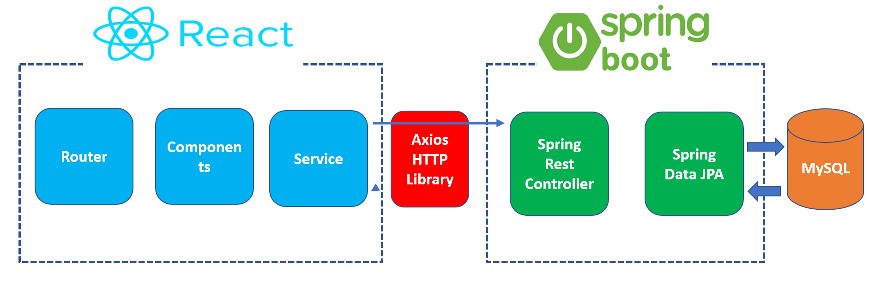
ARCHITECTURE​

Slide 5
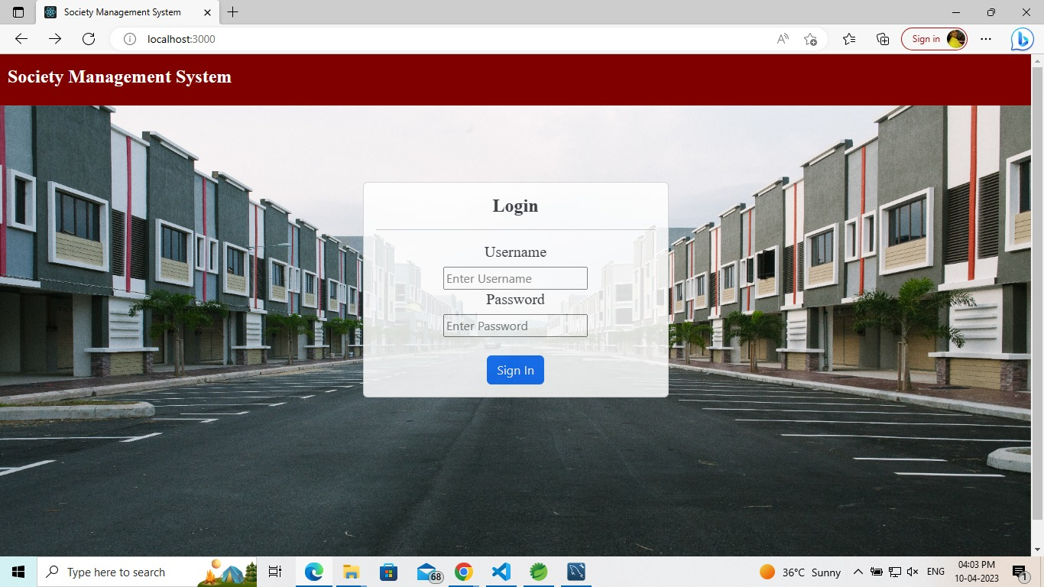
Login Page for Committee and Residents

Slide 6
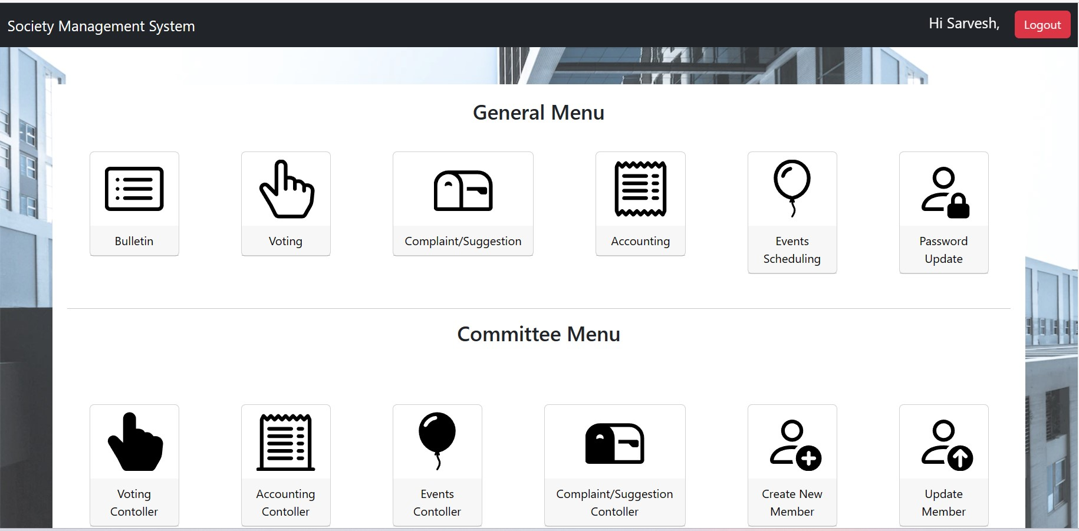
Committee Member Interface

Slide 7
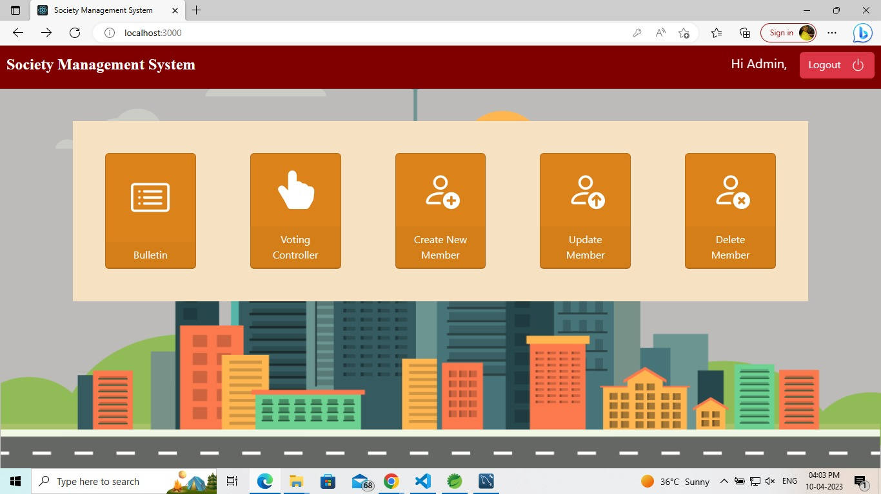
Society Member Interface

Slide 8
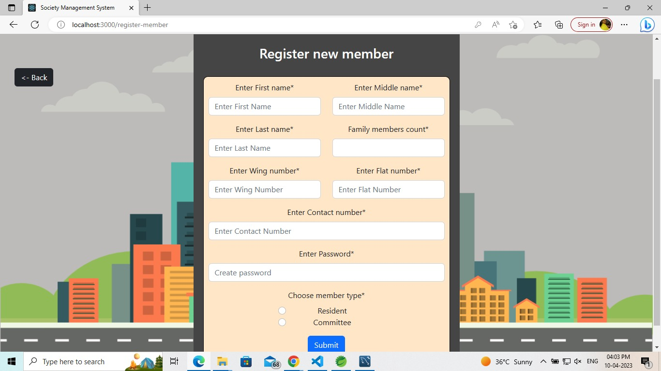

Slide 9
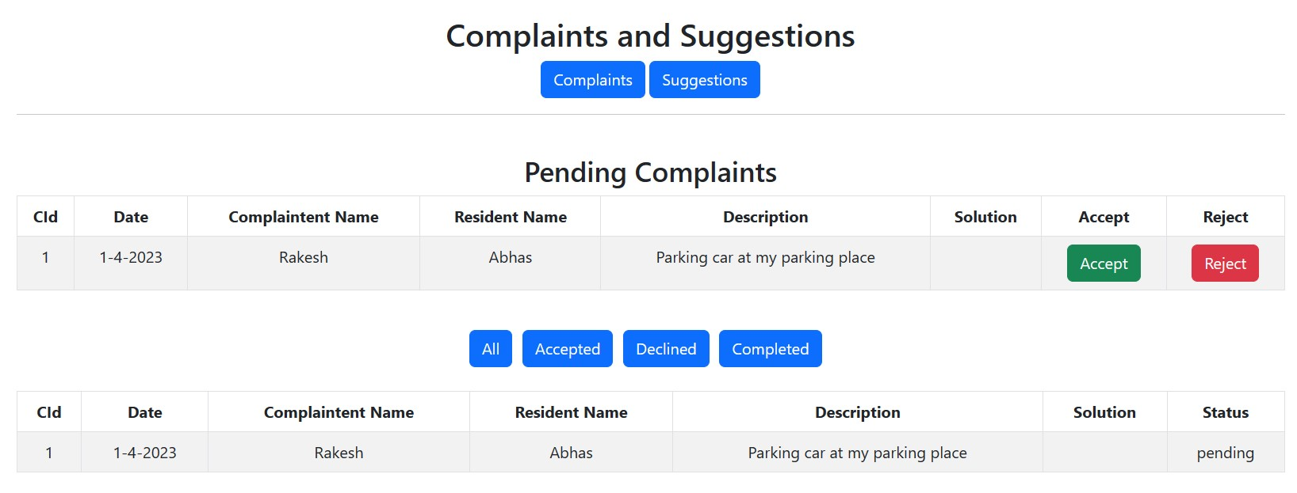

Slide 10
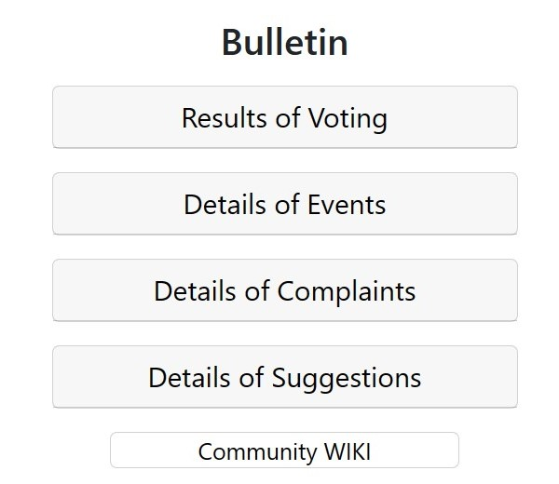
Bulletin Page

Slide 11
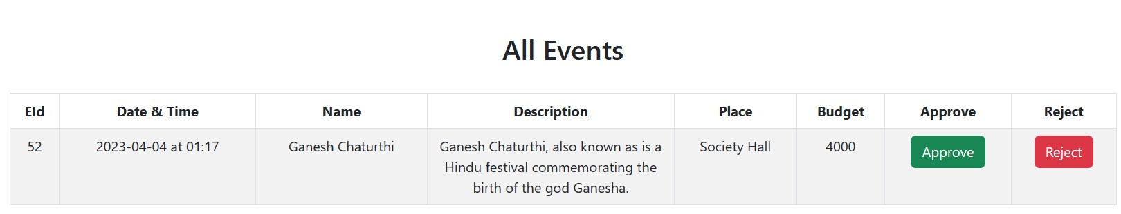
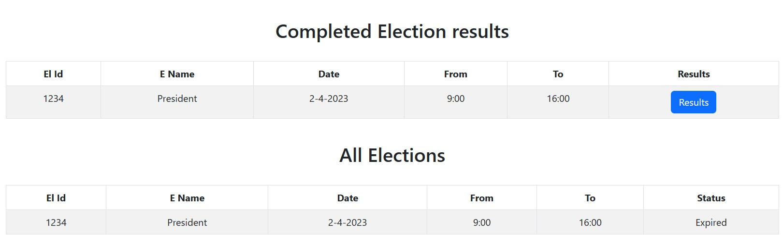

Slide 12
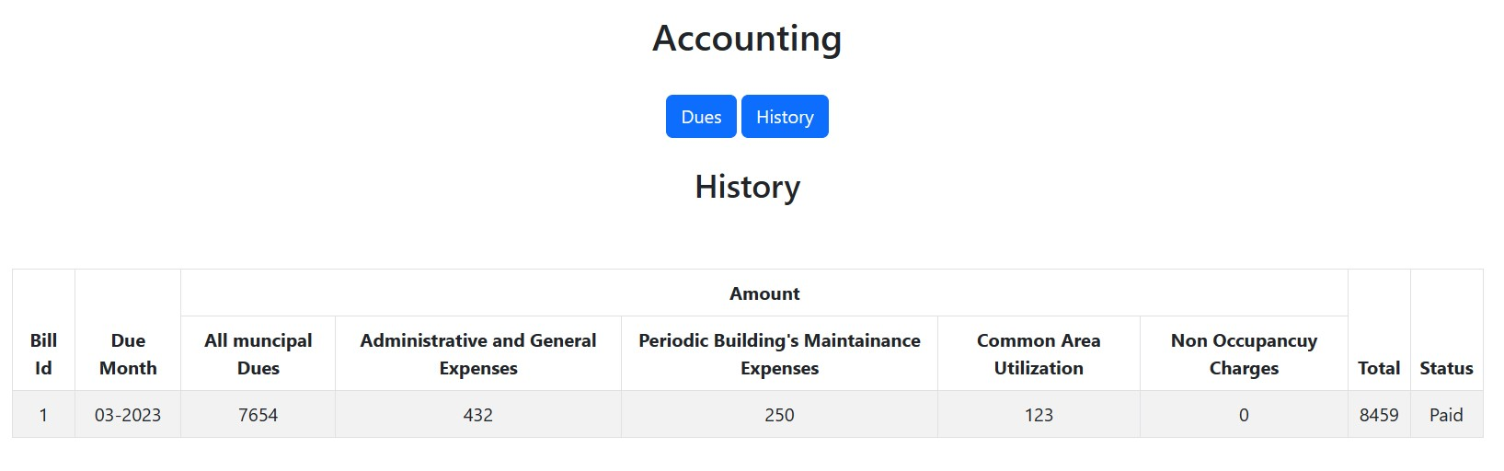

Slide 13
In conclusion, To overcome the drawbacks of existing system, this project is proposing a smarter way of communication and automates online voting system, online hall allocation, online complain/suggestion registration in which society member can make complain form anywhere, any time and committee with the help of the system resolve the Complain as soon as possible, etc.
CONCLUSION​

Slide 14
Thank You

